Slide 1
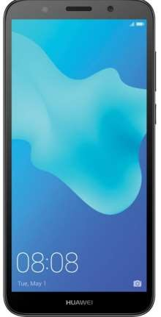


SAMPANN APP
Download SAMPANN APP from
Controller of Communication Accounts, Kerala

Slide 2



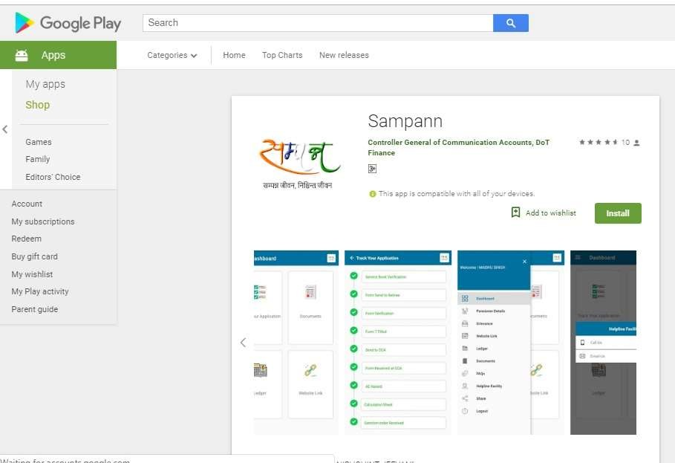
INSTALL SAMPANN APP
LL
NN”
Controller of Communication Accounts, Kerala

Slide 3


HOW TO REGISTER ?
•
Username is created when Retiree Profile is created
Head of Office Level.
at
•
Username is always PAN of the retiring employee.
•
Password is sent to the retiring employee’s mobile
number.
Password
Controller of Communication Accounts, Kerala

Slide 4

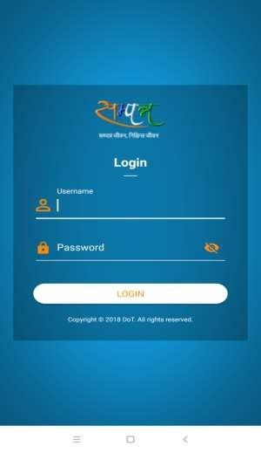
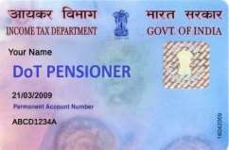

OPEN “SAMPANN” APP
Enter PAN No of Pensioner
Enter Password
Controller of Communication Accounts, Kerala

Slide 5

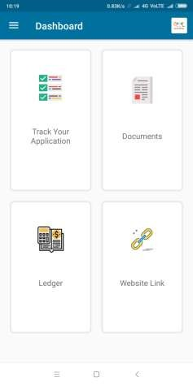
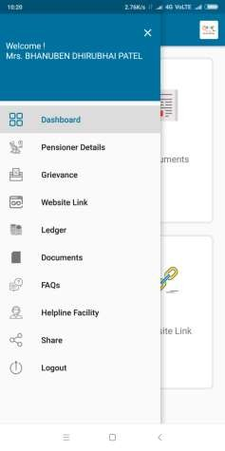
DASHBOARD OF “SAMPANN” APP
Dashboard
xxxxxx
Menu
Controller of Communication Accounts, Kerala

Slide 6

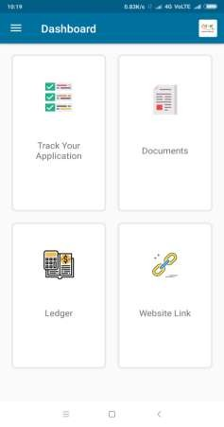
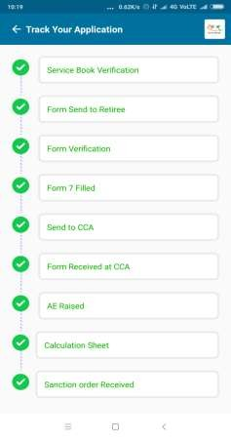
VIEW STATUS OF PENSION CASE
Click on Track and View Status
Controller of Communication Accounts, Kerala

Slide 7

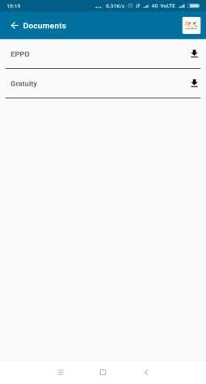
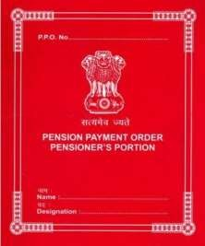
DOWNLOAD DOCUMENTS
Click on Documents
Controller of Communication Accounts, Kerala

Slide 8

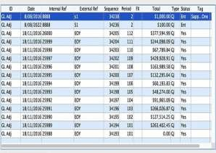
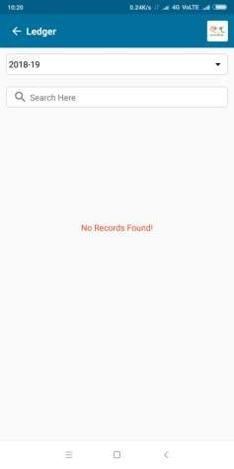
VIEW LEDGER
Click on Ledger
Controller of Communication Accounts, Kerala

Slide 9



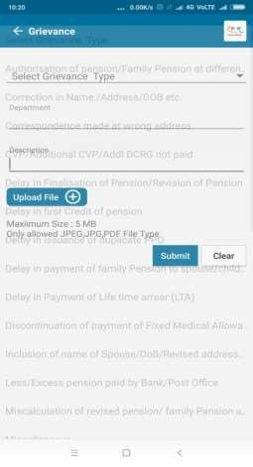
REGISTER GRIEVANCES
xxxxxx
Click on Grievance
Controller of Communication Accounts, Kerala

Slide 10

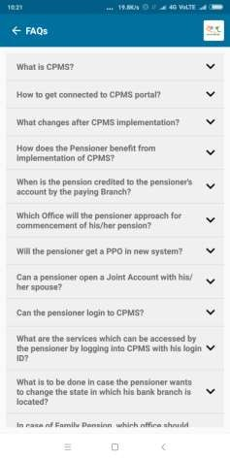

FREQUENTLY ASKED QUESTIONS
xxxxxx
Click on FAQs
Controller of Communication Accounts, Kerala

Slide 11
Thank
You
Controller of Communication Accounts, Kerala

